Slide 1

Beer Image Tracker
Perceptions about Beer and Breweries in Europe
Results Spain

Slide 2
Evaluations of Breweries in Spain - Non-users versus Total
Breweries have a much stronger reputation among the total general public than among non users of beer. Yet, the gap is smaller than is the case for Europe as a whole.
Non users only acknowledge Breweries less for being ‘innovative’, ‘open about activities’ and ‘committed to making society better’ than the general public. Remarkably, non users are even more positive about the ‘environmental responsibility’ and ‘job creation in Spain’ of Breweries.

Slide 3
Evaluations of Breweries in Europe - Non-users versus Total
The differences in evaluations of non users of beer and the total general public are much larger for Europe than for Spain.
Additionally, non users are quite critical in Europe while in Spain perceptions of non users about Breweries are average to strong.

Slide 4

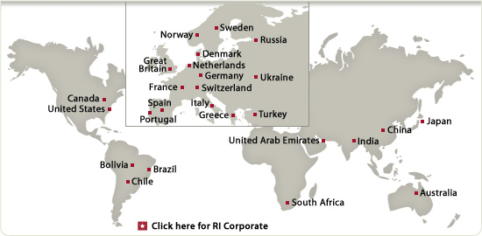
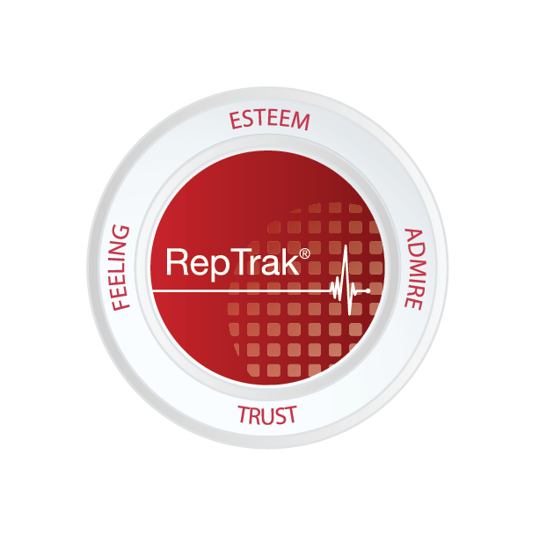
About Reputation Institute
Reputation Institute is the leading international organization devoted to advancing knowledge about corporate reputations. Through systematic research and analysis, Reputation Institute helps companies build comprehensive strategies and make operational decisions that are designed to align stakeholders with corporate objectives and create tangible economic value. Reputation Institute's global network of local offices, associates, practitioners, and academics regularly produces thought leadership about corporate reputations that is shared in our conferences and workshops, and gets featured in our newsletters and peer-reviewed quarterly journal, Corporate Reputation Review.
RI Global Network of Offices and Associates

